Slide 1
WEATHER SHIFT PREDICTION.
TEAM-13
Muskan Havaldar - 01fe19bcs007.
Swathi Pardeshi - 01fe19bcs060.
Srishti Eligar - 01fe19bcs042.
Ankita Mane - 01fe19bcs052.

Slide 2
WEATHER SHIFT PREDICTION
A prediction is a statement which tries to explain a possible outcome or a possible event.
Weather shift prediction is the prediction for long-term alteration of temperature and typical weather patterns in a place.

Slide 3
DIFFERENCES BETWEEN WEATHER SHIFT AND WEATHER FORECASTING
WEATHER FORECASTING
A forecast refers to a calculation or an estimation which uses data from previous events, combined with recent trends to come up a future event outcome.
WEATHER SHIFT PREDICTION
Prediction is an actual act of indicating that something will happen in the future with or without prior information.

Slide 4
GOAL AND CHALLENGES
GOAL
The goal is to predict the temperature at a particular latitude/longitude and time, given all available measurements and climate model predictions.
CHALLENGES
Training data is not uniformly distributed across different climate zones. Weather systems are highly non-stationary processes.

Slide 5
ALL ABOUT THE DATA
We have three datasets to work on for now
1] train.csv- Data for training
2] dev_in.csv- Development data from the same domain in time and climate as of the train.csv data
3] dev_out.csv- Data distributionally shifted in time and climate from train.csv
We have 3129592 rows and 129 columns as provided in the training data set

Slide 6
ATTRIBUTES
META-DATA
fact_time
fact_latitude
fact_longitude
fact_temperature
fact_cwsm_class
climate

Slide 7
Canadian Meteorological Center(CMC) model : 56 attributes
Weather Research and Forecasting (WRF) model : 13 attributes
Global Forecast system predictions(GFS) : 50 attributes
topography_bathymetry
sun_elevation
climate_temperature
climate_pressure

Slide 8
PLOTS
1] Climate distribution
2] fact_temperature v/s fact_time
3]climate pressure v/s fact_temperature

Slide 9
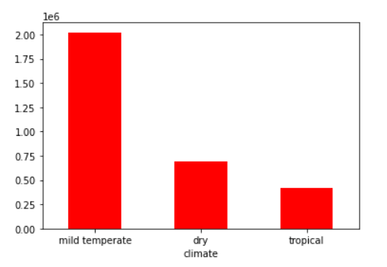
CLIMATE DISTRIBUTION

Slide 10
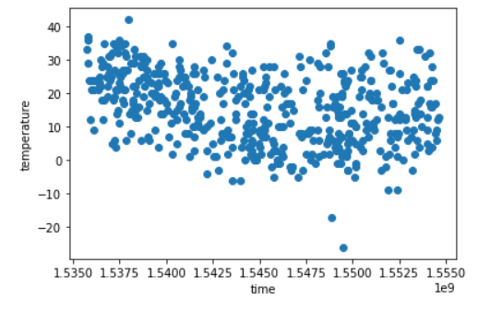
fact_temperature v/s fact_time

Slide 11
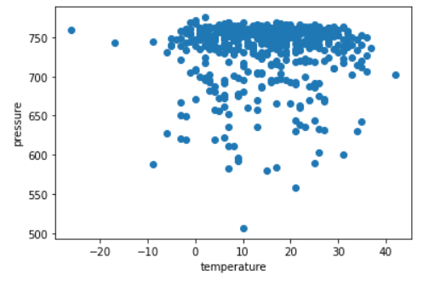
climate pressure v/s fact_temperature

Slide 12
THANK YOU!

